Slide 1

REPORT ON DIP PROJECT
AutoToon: Automatic Geometric Warping for Face Cartoon Generation
Lecturer: PhD Le Thi Lan
PhD Tran Thi Thanh Hai
Student: Le Thi Ha Thu – 20224292
Nguyen Ngoc Thuy Linh - 20224323

Slide 2
Table of contents
I. Introduction
II. Methodology
III. Experiment
IV. Evaluation
V. References

Slide 3
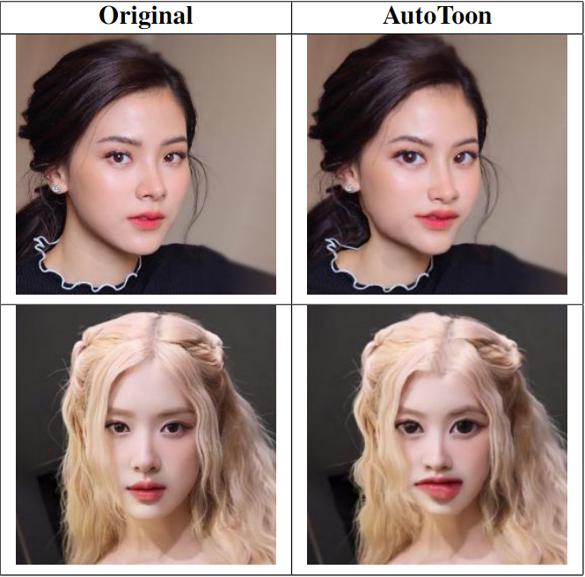
I. Introduction
AutoToon is a deep learning method that yields high-quality warps for the warping component of caricatures.
Input: facial image in a standard photo format (e.g. PNG, JPG).
Output: a cartoonized version of the input image with exaggerated geometric features.
Figure 1: Input and Output of the method

Slide 4
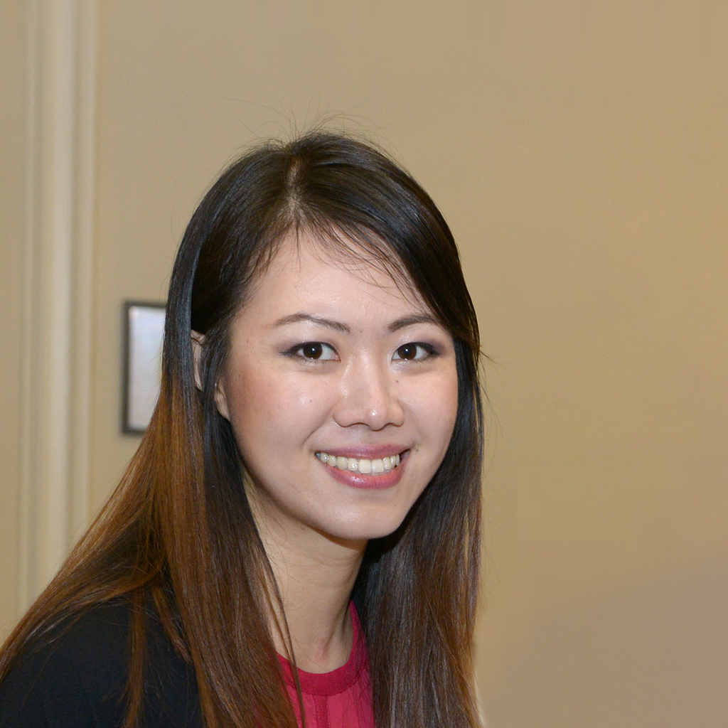
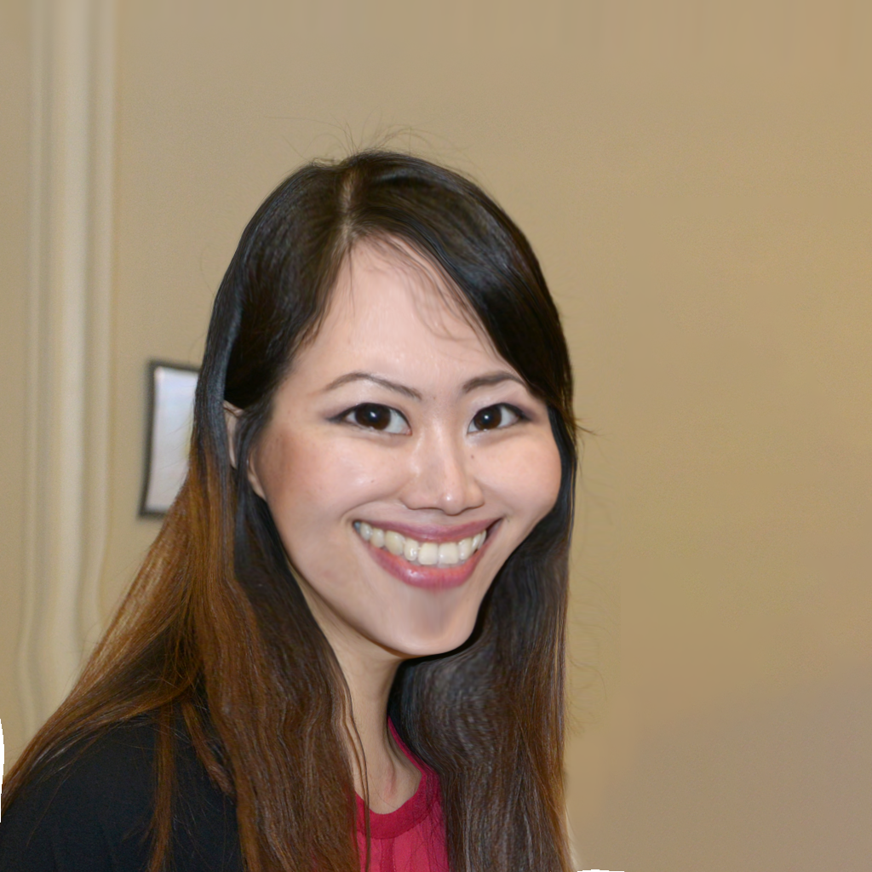
II. Methodology
Dataset
A dataset of 101 frontal-facing portrait images was gathered from Flickr. These images were transformed into caricatures to create ground-truth labels.
Figure 2.1 & Figure 2.2: Dataset images

Slide 5
II. Methodology
2. Model Architecture
SENet-50 (Squeeze-and-Excitation Network 50 Layers)
The SENet-50 plays a pivotal role in the AutoToon project, primarily focusing on generating geometric warping fields for cartoonization.
1.1. Architecture in AutoToon
1.2. Adaptations for AutoToon
1.3. Training SENet-50 in AutoToon

Slide 6
II. Methodology
1.1. Architecture in Auto Toon
Squeeze-and-Excitation (SE) Modules: Enhances the model’s attention mechanism by:
Squeezing: Aggregating spatial information through global average pooling.
Exciting: Generating channel-wise weights to emphasize important features.
This allows SENet-50 to focus on key features, such as facial landmarks and edges, improving its performance for tasks like warping field prediction.

Slide 7
II. Methodology
1.2. Adaptations for Auto Toon
Removing Fully Connected Layers: In AutoToon, the fully connected layers of SENet-50 are removed, allowing the model to produce spatial feature maps instead of class probabilities.
Generating the Warping Field:
SENet-50 outputs a warp grid of size (1, 2, 32, 32), representing pixel displacements in the x- and y-directions.
This warp grid is upsampled to 256x256 using bilinear interpolation to match the input image size.
The generated warping field is then applied to deform the input image, creating the cartoonized output.

Slide 8
II. Methodology
1.3. Training SENet-50 in Auto Toon
Pretrained Weights: SENet-50 is initialized with weights pretrained on the VGGFace2 dataset, aiding in face-related tasks.
Fine-Tuning: The model is fine-tuned on the AutoToon dataset to learn cartoon-specific warping patterns.
Loss Functions: The output warping field is trained using a combined loss function.

Slide 9
II. Methodology
2. Model Architecture
SENet-50 (Squeeze-and-Excitation Network 50 Layers)
Enhancing Feature Detection: SENet-50 boosts CNN models' ability to recognize key features like edges, colors, and shapes, improving sharpness and detail in cartoon conversion.
Sharper Cartoon Images: It emphasizes cartoon-specific features like sharp outlines, bright colors, and simplified shapes, crucial for realistic cartoon generation.
Improving Output Quality: Combined with GANs, SENet-50 helps create more realistic, sharp cartoon images by refining color transformations and outlines.

Slide 10
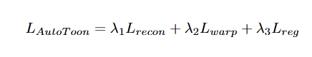
II. Methodology
3. Loss function
The loss function used to train our model is:
Reconstruction Loss (L​_{recon}): Ensures the generated caricature matches the artist's ground truth.
Warping Loss (L_{warp}​): Aligns the predicted geometric warping with the artist's exaggeration.
Regularization Loss (L_{reg}): Promotes smooth and natural warping to avoid artifacts.
Each term is weighted by λ₁, λ₂, λ₃ to balance their contributions during training. This ensures high-quality and visually appealing cartoon outputs.

Slide 11



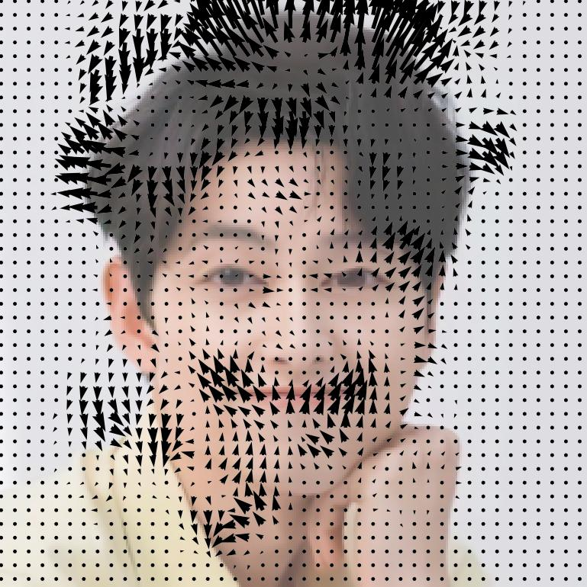
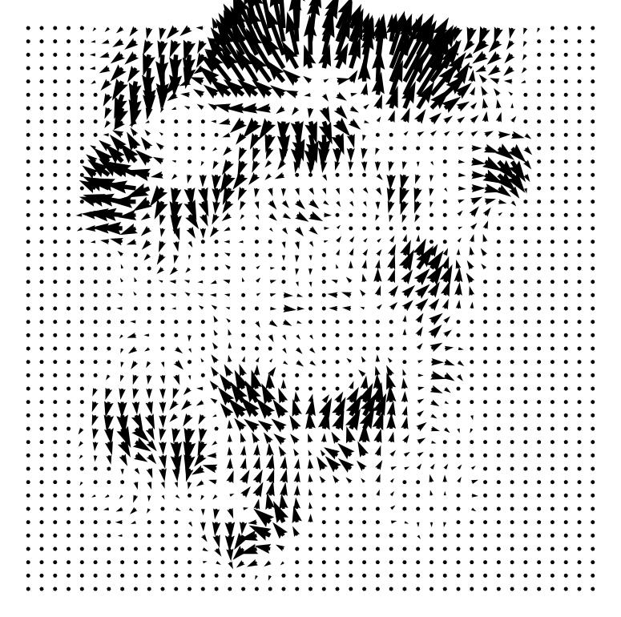
III. Experiment
Figure 3.1: Original image
Figure 3.2: Output images after AutoToon

Slide 12
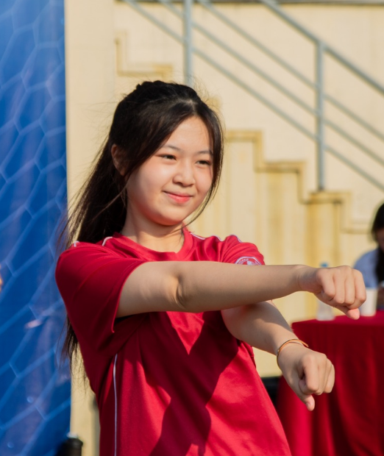
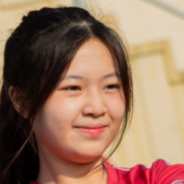
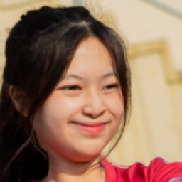
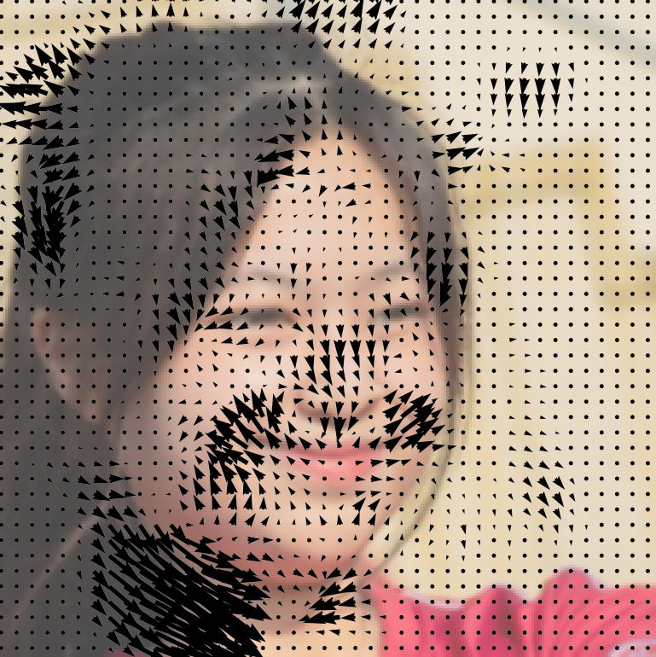
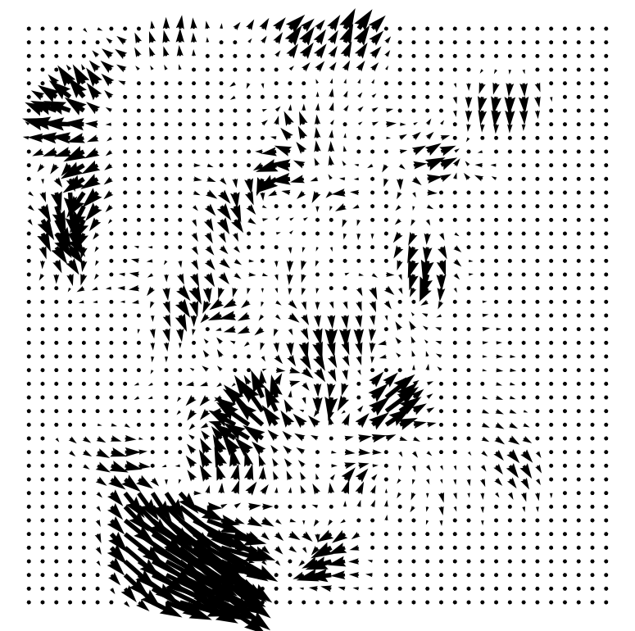
III. Experiment
Figure 3.3: Original image
Figure 3.4: Output images after AutoToon

Slide 13

III. Experiment
Testing with picture has many face (6 faces), we collect 6 warping images of 6 people.
Figure 3.5: Original image

Slide 14
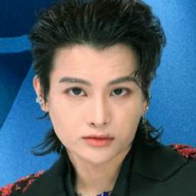
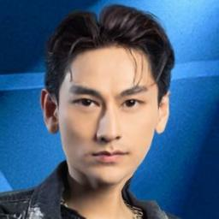
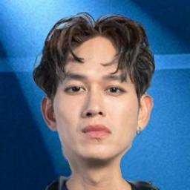
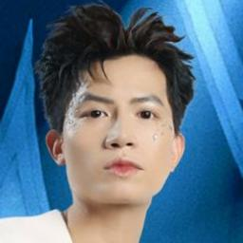
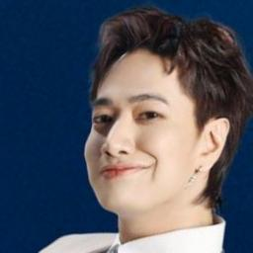

III. Experiment
Testing with picture has many face (6 faces), we collect 6 warping images of 6 people.
Figure 3.6: Output images after AutoToon

Slide 15
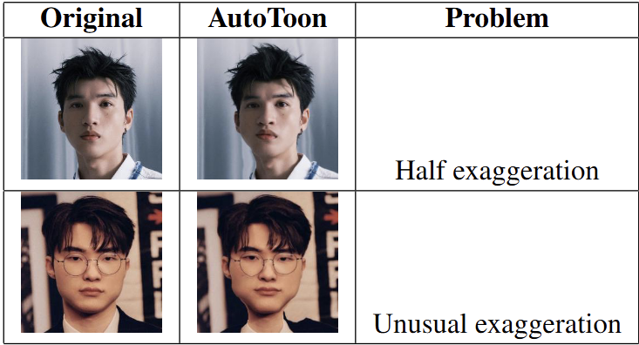
III. Experiment
Failed tests
Table 3.7: Failed output images after AutoToon

Slide 16
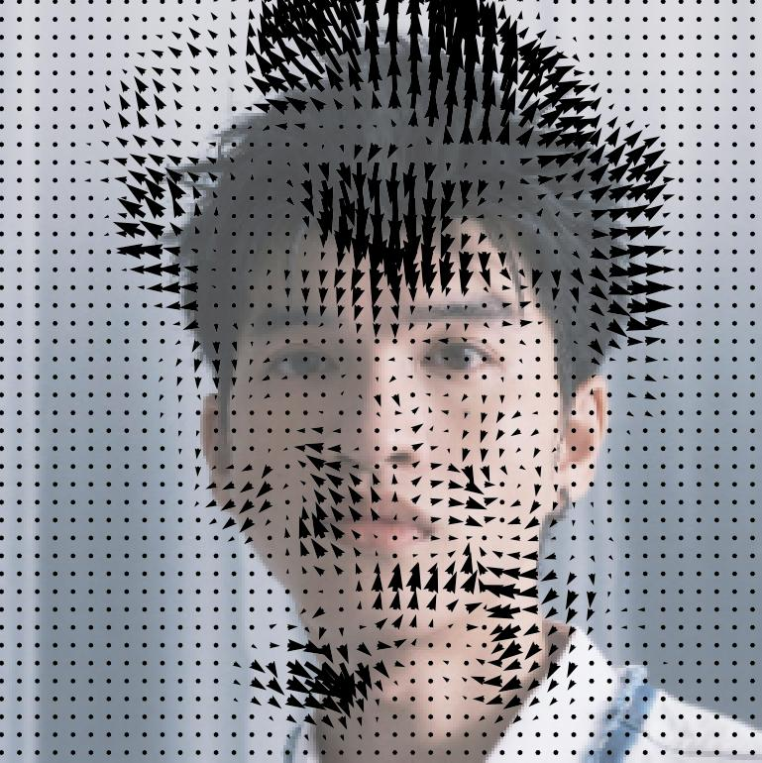
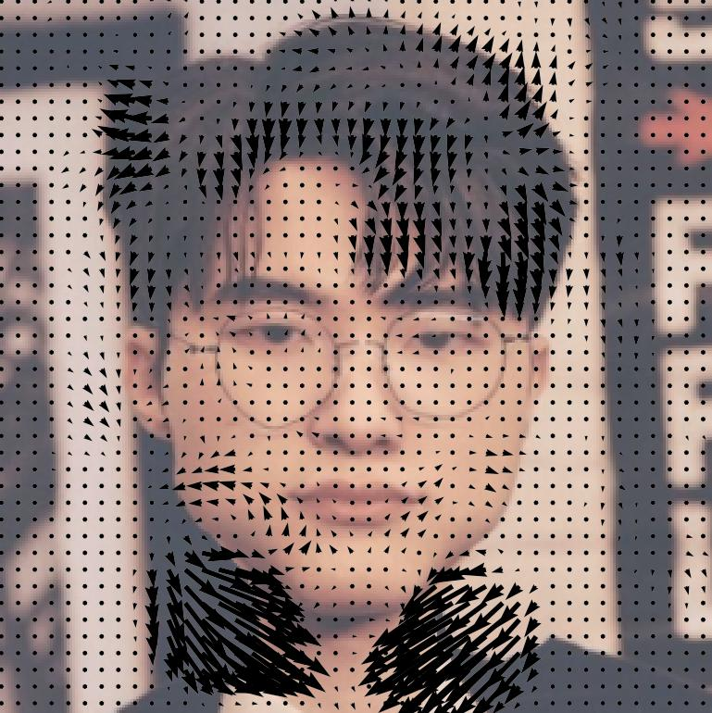
III. Experiment
Figure 3.8: Output of failed test
Figure 3.9: Output of failed test

Slide 17
IV. Evaluation
The average MSE=479.2 is high, which means the output has undergone substantial transformations compared to the original.
The average SSIM = 0.86 is quite good, suggest that the structural integrity and overall visual characteristics of the original image have been well-preserved.
The average PSNR = 21.32 dB is not high, but it is acceptable for Autotoon.

Slide 18
V. References
[1] DeepWarp: Photorealistic Image Resynthesis for Gaze Manipulation
[2] Learning Perspective Undistortion of Portraits
[3] Synthesizing Normalized Faces from Facial Identity Features
[4] Parallax-tolerant Image Stitching
[5] CariGANs: Unpaired Photo-to-Caricature Translation
[6] WarpGAN: Automatic Caricature Generation
[7] AutoToon: Automatic Geometric Warping for Face Cartoon Generation

Slide 19
THANK YOU !

